Slide 1



Assessment of regulatory models for the implementation of smart metering systems in the Brazilian distribution system (low voltage)
Ailson de Souza Barbosa
Marcos Vasconcelos
Pedro Melo
Regulatory Specialists at ANEEL
Tbilisi, 9/September/2026

Slide 2

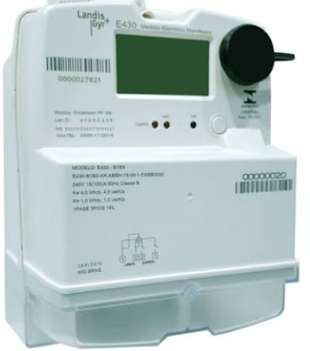
The Brazilian Electricity Sector in NUMBERS
NUMBER OF CONSUMERS
91.6 MILLION
ACCESS TO ELECTRICITY
99.8%
of the population
ENERGY MARKET (2025)
647.4 TWh/year
TRANSMISSION (2025)
181,782 km
ELECTRICITY LOSSES (2025)
14.7%
TL: 7.4% NTL: 7.3%
SMART METERING (2025)
Diffusion: 4%
CENTRALIZED GENERATION CAPACITY (2025)
218 GW
DISTRIBUTED GENERATION CAPACITY (2025)
49.4 GW

Slide 3

The Brazilian Electricity Sector in NUMBERS
Total de 102 utilities
NUMBER OF CONSUMERS
91.6 MILLION
ACCESS TO ELECTRICITY
99.8%
of the population
ENERGY MARKET (2025)
647.4 TWh/year
TRANSMISSION (2024)
176,169 km
ELECTRICITY LOSSES (2025)
14.7%
TL: 7.4% NTL: 7.3%
SMART METERING (2025)
Diffusion: 4%
CENTRALIZED GENERATION CAPACITY (2025)
218 GW
DISTRIBUTED GENERATION CAPACITY (2025)
49.4 GW

Slide 4
Why has smart metering become a strategic regulatory issue for Brazil?

Slide 5
Diagram of Objectives and Expected Results for Regulation
Improve efficiency of electricity distribution services
Increase consumer awareness and optimize electroenergetic resources
from the country
Empowering consumers through market opening, greater transparency, and provision of new services
Improve the management and dissemination of DER
Improve levels of quality and speed in the transfer of collective information
Implement new regulations with the lowest possible tariff impact and risk for the end consumer
1
Reduce
regulatory barriers to the implementation of smart metering systems in Brazil
2
3
Regulatory Problem
4
5
6
The installation of smart meters aligns with the energy transition and the modernization of the Brazilian distribution sector, contributing to a more efficient, transparent, reliable, and sustainable service

Slide 6

Methodological approach: monetizable + non-monetizable criteria
CBA was integrated into AHP to support a balanced regulatory decision
1. Define alternatives
A0, A1, A2
2. CBA - Cost-Benefit Analysis
Quantify costs, monetizable benefits, NPV and B/C ratio
3. AHP - Analytic Hierarchy Process
Compare alternatives against qualitative and quantitative criteria
4. Sensitivity
Test robustness of CBA inputs and AHP weights
5. Recommendation
Select alternative aligned with objectives and public policy

Slide 7
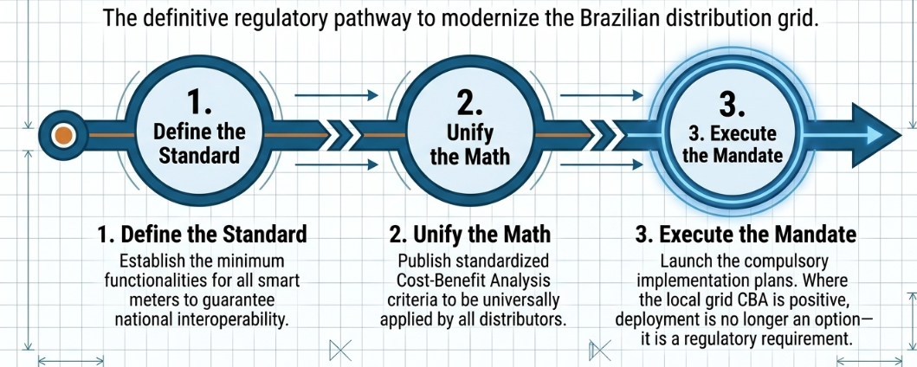
Conclusions

Slide 8

Thank you!
References: ANEEL, GIZ, PSR Energy, SIGLASUL
Ailson de Souza Barbosa
Regulatory Specialist at ANEEL
Brasilian Electricity Regulatory Agency
ailson@aneel.gov.br
www.aneel.gov.br

